Slide 1

Software Development & Best Practices
This Photo by Unknown Author is licensed under CC BY-SA
Lecture 8 – SQL Injection

Slide 2
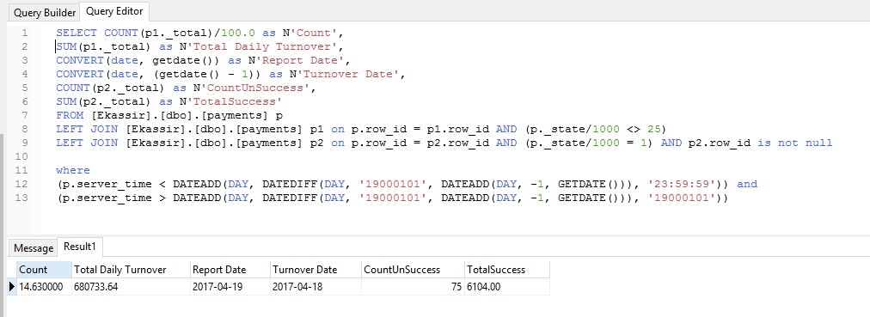
Databases and SQL
This Photo by Unknown Author is licensed under CC BY-SA

Slide 3

Databases and SQL
Any reasonably sophisticated web application is going to use large amounts of data.
This data can be anything from items in your shopping cart, usernames and passwords to the money a company owes their suppliers.
The most common way to store all these kinds of data is in a database.
A database is a word we use for a collection of related data which a computer can access.
This Photo by Unknown Author is licensed under CC BY-NC

Slide 4
Databases and SQL
Early in the history of software development many programming languages had special commands to work with databases.
Today, the most common way (although this is changing) that web applications interact with a database is through a programming language called SQL – Structured Query Language.
SQL acts as a standard way to manipulate data in a database.
This Photo by Unknown Author is licensed under CC BY-NC

Slide 5
Databases and SQL
Databases manipulate data in four main ways…
Create: They add new data to the database.
Read: They retrieve existing data from the database.
Update: They alter data that exists in the database.
Delete: They remove data that exists in a database.
These are often referred to collectively by the acronym CRUD.
This Photo by Unknown Author is licensed under CC BY-NC

Slide 6
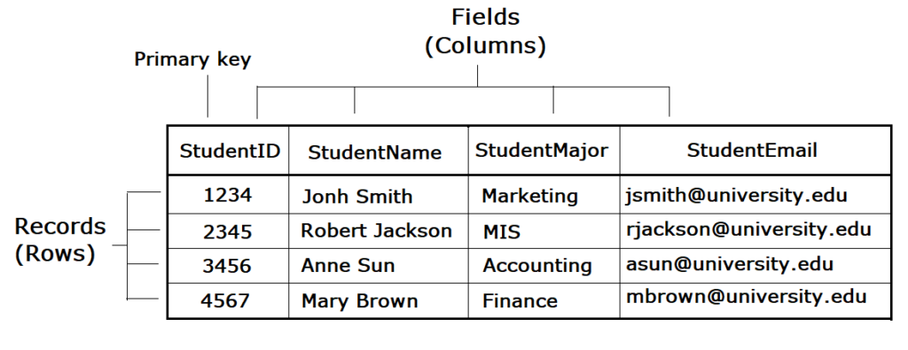
Databases and SQL
Most databases store data as sets of rows and columns – like a spreadsheet.
The columns (which we often call fields) represent the specific qualities we are storing: “age”, “price”, “description”, etc…
The rows (which we often call records) represent how those qualities apply to a specific item. i.e., Dave's age is 47 years.
This Photo by Unknown Author is licensed under CC BY-NC

Slide 7
Databases and SQL
We frequently collect the rows and columns about a specific kind of thing (students, items, cars) and put them together in a structure called a table.
SQL Databases work exclusively on data in tables.
In these next few slides, we will discuss how SQL can be used to access data from a table.
It’s worth pointing out that a programming language like PHP still needs a way to send SQL to a particular database but we will discuss that later…
This Photo by Unknown Author is licensed under CC BY-NC

Slide 8
SQL - SELECT
To READ information from a SQL database we use the command SELECT.
We provide it at least two pieces of information
The name of a table we are working on.
The columns we want to see.
We can also use it to filter out some rows (records) and only show us the ones we are interested in. This is done using a WHERE clause.
We can use AND and OR to create more complex filters.
Names | Age
Larry Smith | 24
Xiao Li | 34
Sarah Simms | 65
> SELECT names, age FROM people;
Larry Smith 24 Xiao Li 34 Sara Simms 65
> SELECT names FROM people WHERE age > 25; Xiao Li Sara Simms

Slide 9
SQL - INSERT
To CREATE new data in a SQL database. We use the INSERT command.
The minimal amount of data we need to provide are the columns we are populating and the values we are going to put into them.
In SQL, strings are encased in single quotes, column names are not, and neither are numbers.
Names | Age
Larry Smith | 24
Xiao Li | 34
Sarah Simms | 65
> INSERT INTO people (names,age) VALUES ('Ip Man',127);
Name | Age
Larry Smith | 24
Xiao Li | 34
Sarah Simms | 65
Ip Man | 127

Slide 10
SQL - UPDATE
To change data in an SQL database we used the UPDATE command.
UPDATE requires a table name, the “SET “ keyword, a column name as well as a condition which is put into a WHERE clause. If you omit the WHERE clause, then the value specified in SET is applied to every record.
UPDATE allows us to change all or part of across an entire table.
Name | Age
Larry Smith | 24
Xiao Li | 34
Sarah Simms | 65
Ip Man | 127
> UPDATE people SET age = 20 WHERE age < 35;
Name | Age
Larry Smith | 20
Xiao Li | 20
Sarah Simms | 65
Ip Man | 127

Slide 11
SQL - DELETE
To remove data from an SQL database. We use the DELETE command.
DELETE just requires a table name and a condition which is put into a WHERE clause.
Like UPDATE if you omit the WHERE clause then every record is deleted.
We can delete as many or as few rows as we want..
Name | Age
Larry Smith | 20
Xiao Li | 20
Sarah Simms | 65
Ip Man | 127
> DELETE people WHERE age = 20;
Name | Age
Sarah Simms | 65
Ip Man | 127

Slide 12
SQL & PHP
In this course our database exists on the same computer (a virtual machine) that our web server is running on but that doesn’t have to be the case. In large environments it’s common to have a central database server or several of them called a “cluster. On top of that even a singe computer can host a large number of databases.
Because of this, PHP will need some information about where our database is located in order to access it.
The first bit of information PHP needs is the database type. In the case of our TurnKey Linux box, it is MySQL (mariadb) other types of database are things like Microsoft SQL Server and Oracle.
After that we need the database name and the IP address of the server it is located on. If it’s on the same machine that our database is running on, we can write localhost or 127.0.0.1 instead of an IP.
$dsn = 'mysql:dbname=mydatabase;host=172.16.1.242'; $dbUser = 'appuser'; $dbPassword = 'Testing!';

Slide 13
SQL & PHP
After that we need a username and a password.
Databases usually keep their own authentication systems. So, your database username and password will almost always be different from the username and password you use to log into a computer. Even the computer that the database is running on.
You set up a database password on your TurnKey Linux VM the first time it started up. If you recall, after you set the root password it asked you for the password for adminer. Adminer is a database user with administrative privileges.
You can create other users from the Adminer console at: https://<your servers ip>:12322/
$dsn = 'mysql:dbname=mydatabase;host=172.16.1.242'; $dbUser = 'appuser'; $dbPassword = 'Testing!';

Slide 14
SQL & PHP
Once we have all that information, we use it to tell PHP we want to create a connection to this database.
For this course we will be doing this with a system called PDO – the PHP Data Objects interface. PDO returns to us a “handle” similar to the way fopen() does. We can use this to call other database functions.
$dsn = 'mysql:dbname=mydatabase;host=172.16.1.242'; $dbUser = 'appuser'; $dbPassword = 'Testing!'; $db = new PDO($dsn,$dbUser,$dbPassword); $query_string = 'SELECT name, age FROM people'; $cursor = $db->query($query_string); while ( $data = $cursor->fetchObject() ) { printf('%s %s',$data->name,$data->age); }

Slide 15
SQL & PHP
When we send SQL commands to the database. We often refer to this as “sending a query” or “Querying the database”.
To send a query to the database we put the SQL in a string. Which we’ve called $query_string in this example.
$dsn = 'mysql:dbname=mydatabase;host=172.16.1.242'; $dbUser = 'appuser'; $dbPassword = 'Testing!'; $db = new PDO($dsn,$dbUser,$dbPassword); $query_string = 'SELECT name, age FROM people'; $cursor = $db->query($query_string); while ( $data = $cursor->fetchObject() ) { printf('%s %s',$data->name,$data->age); }

Slide 16
SQL & PHP
You can think of this handle $db as a variable that contains both variables and functions. The correct term for this is an “object”. The -> operator let’s us access the variables and functions of an object.
To get the database to run our query we use the $db object’s query()function. We provide it with SQL commands that we have put in the variable $query_string. The result of this is another object, which we call $cursor.
$dsn = 'mysql:dbname=mydatabase;host=172.16.1.242'; $dbUser = 'appuser'; $dbPassword = 'Testing!'; $db = new PDO($dsn,$dbUser,$dbPassword); $query_string = 'SELECT name, age FROM people'; $cursor = $db->query($query_string); while ( $data = $cursor->fetchObject() ) { printf('%s %s',$data->name,$data->age); }

Slide 17
SQL & PHP
To retrieve the data, we call the fetchObject() function that is part of our $cursor object. The result is an object called $data.
The individual columns exist as variables which are part of the $data object. The -> operator lets us grab them.
$dsn = 'mysql:dbname=mydatabase;host=172.16.1.242'; $dbUser = 'appuser'; $dbPassword = 'Testing!'; $db = new PDO($dsn,$dbUser,$dbPassword); $query_string = 'SELECT name, age FROM people'; $cursor = $db->query($query_string); while ( $data = $cursor->fetchObject() ) { printf('%s %s',$data->name,$data->age); }

Slide 18
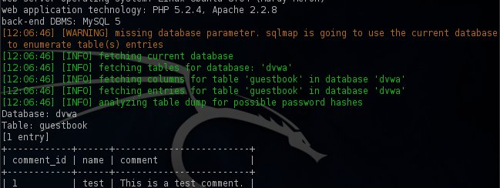
SQL Injection
This Photo by Unknown Author is licensed under CC BY-SA-NC

Slide 19
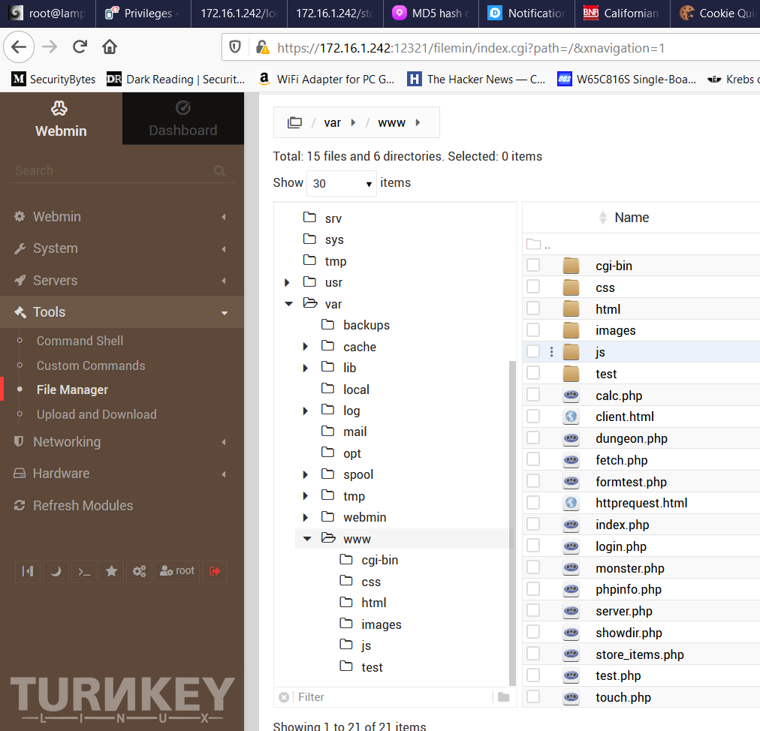
SQL Injection
That may seem like a lot of information, but it really is important to understand how this kind of injection attack works.
If you’re following along. Download the zip files associated with this lecture.
Upload the PHP files to /var/www on your server using file manager.

Slide 20
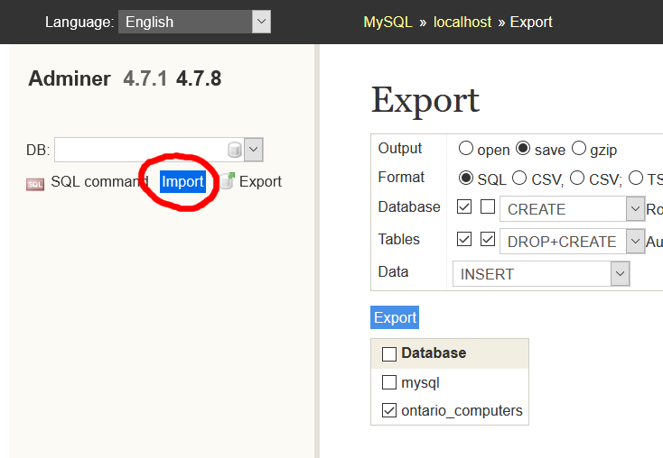
SQL Injection
You will now need to log into Adminer
If you have forgotten your database password. Then log into the webconsole
https://<your server’s ip>:12320/
As ‘root’ and run the command: mysql_secure_installation.
When you are prompted to set the root password select “y” and follow the instructions.

Slide 21
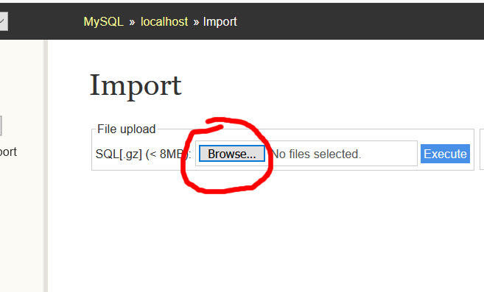
SQL Injection
Once you can log into Adminer and select the import function from the left-hand side.
Click the Browse button from the file upload section.
Locate your file and then select “Execute”.

Slide 22
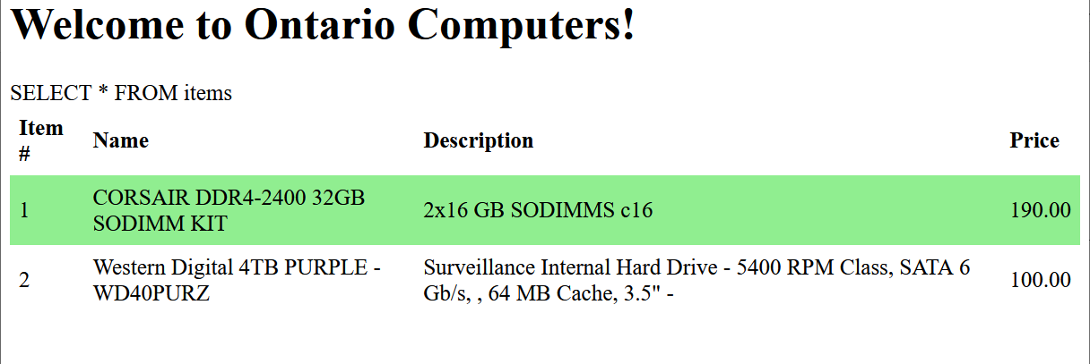
SQL Injection
There is a script store_items.php point your browser at it. You should see something like the image above.
The list of store items is taken from a table in the database.
We have also printed the SQL query that our PHP script is executing. To give you an idea as to what is going on behind the scenes.
In a real attack scenario, you wouldn’t see this.

Slide 23
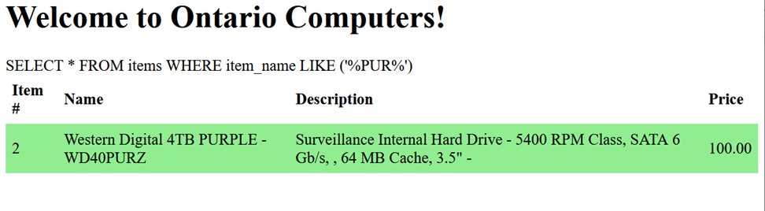
SQL Injection
Our store’s PHP script has a feature that lets people search for specific items in our inventory.
You do this by adding the ?search= parameter on the URL. So the following
http://<<server ip>>/store_items.php?search=PUR
Only returns items with PUR in their names.

Slide 24
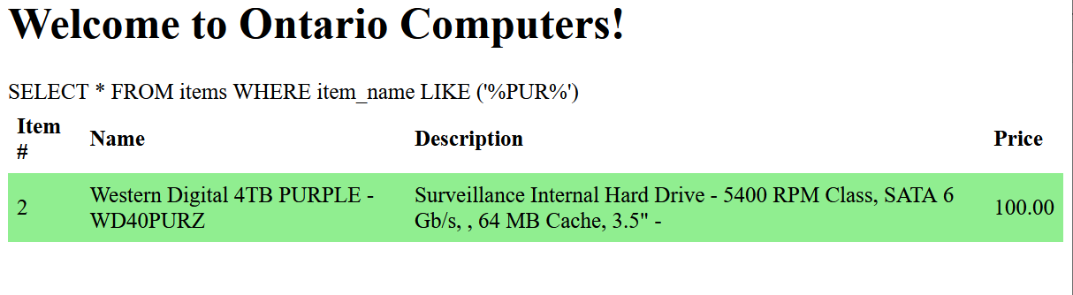
SQL Injection
When we do this, we can see that this causes the SQL that the script is executing to change.
Searching for a particular value causes a “LIKE” clause to be added to the query. LIKE is used in an SQL WHERE clause to match values that are similar but not identical. The “%” sign matches zero or more characters. So…
SELECT * from items WHERE item_name LIKE(‘%TEST%’)
Returns any rows where the item_name contains the term “test”

Slide 25
SQL Injection
If you play around with this, you’ll see no matter what you put in the “search” parameter.
The SQL will simply insert it into the middle of the LIKE clause.
So, let’s try something…

Slide 26
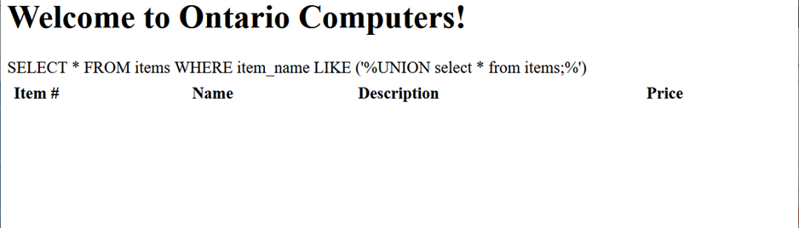
SQL Injection
There is a handy SQL command called UNION. It lets us join one query into another.
If you had two tables A and B and you wanted to see all their data as one big table, you could write:
SELECT * from A UNION SELECT * from B.
This might allow us to change the query so we can get any information we want. First lets just add:
UNION SELECT * from items
To our “?search=“ parameter.
That doesn’t return any items, but it does show us something about how that gets put into the query.

Slide 27
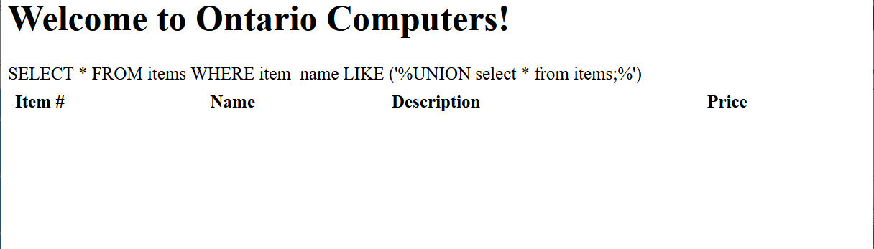
SQL Injection
If you look closely, you can see the problem.
Our new query, just like any other search data ends up in the middle of the LIKE clause.
A LIKE clause needs a quote and a bracket to make it complete. Otherwise, our UNION command will just be treated as if that’s the data we are looking for.
We can accomplish this by adding the quote and the bracket to our search parameter.

Slide 28
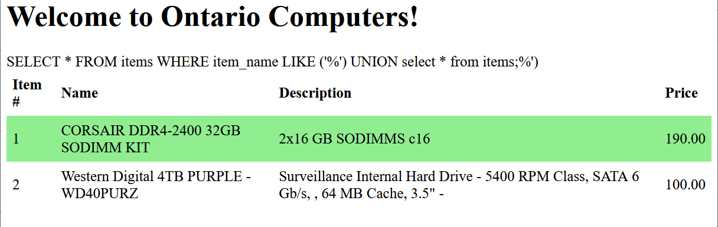
SQL Injection
So now we try setting ?search= to
') UNION select * from items;
As you can see from the SQL this completes the LIKE clause and allows us to use UNION to join these two queries together.
It’s just not doing anything interesting…yet!

Slide 29
SQL Injection
What we would like to do is do some reconnaissance. Maybe take a look through the database and see what other information exists. However, our database is based around tables. So to write any query we need to know the name of the table we want to examine. Thankfully most databases have a query you can run to find all the tables in the database.
In MySQL it is: SELECT TABLE_SCHEMA, TABLE_NAME, COLUMN_NAME FROM INFORMATION_SCHEMA.COLUMNS
To try this, we set ?search= to: ') UNION SELECT TABLE_SCHEMA, TABLE_NAME, COLUMN_NAME FROM INFORMATION_SCHEMA.COLUMNS;

Slide 30
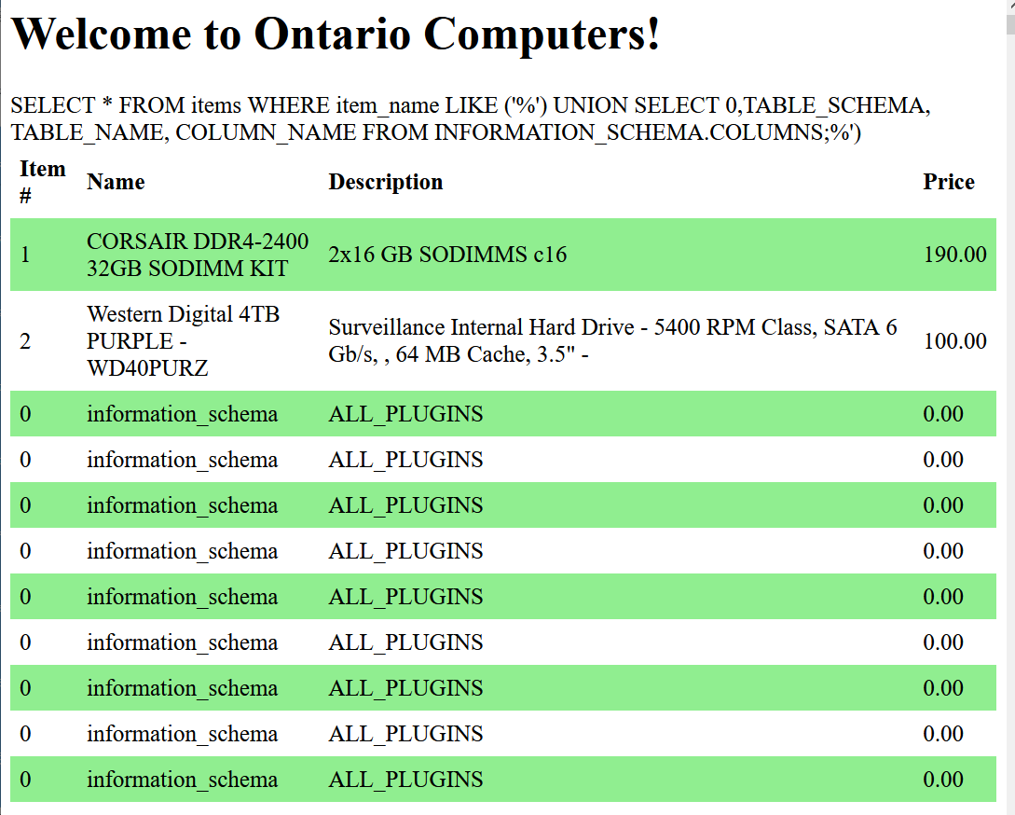
SQL Injection
However, this doesn’t work. This is because there’s a rule about UNION that we haven’t told you about yet: Both queries need to have the same number of columns.
Select * from items has four (item #, name, description and price). But our reconnaissance query has three.
We can fix that by adding a ‘fake’ column. ') UNION SELECT 0, TABLE_SCHEMA, TABLE_NAME, COLUMN_NAME FROM INFORMATION_SCHEMA.COLUMNS;
The 0, just adds a column with all zeros. Now look what we get…

Slide 31
SQL Injection
This is very promising. Our UNIONed query is producing the first two columns (table_schema and table_name) but the third (column_name) is missing? Why?
The reason is that column_name is being forced into the “price” field. Which PHP is formatting as a number.
The column_name field is a string. So, PHP just ends up filling the columns with zeros.

Slide 32
SQL Injection
We can’t control the number of columns in the item query. We need some way to get all the information in the reconnaissance query squeezed into two fields.
Our database system has a command to do just that. CONCAT glues multiple fields together into one field. In our SELECT clause we can change TABLE_SCHEMA to
CONCAT(TABLE_SCHEMA, ' ', TABLE_NAME)
This will put both fields into one column (with a space between them) we can then add TABLE_COLUMN into the second field.

Slide 33
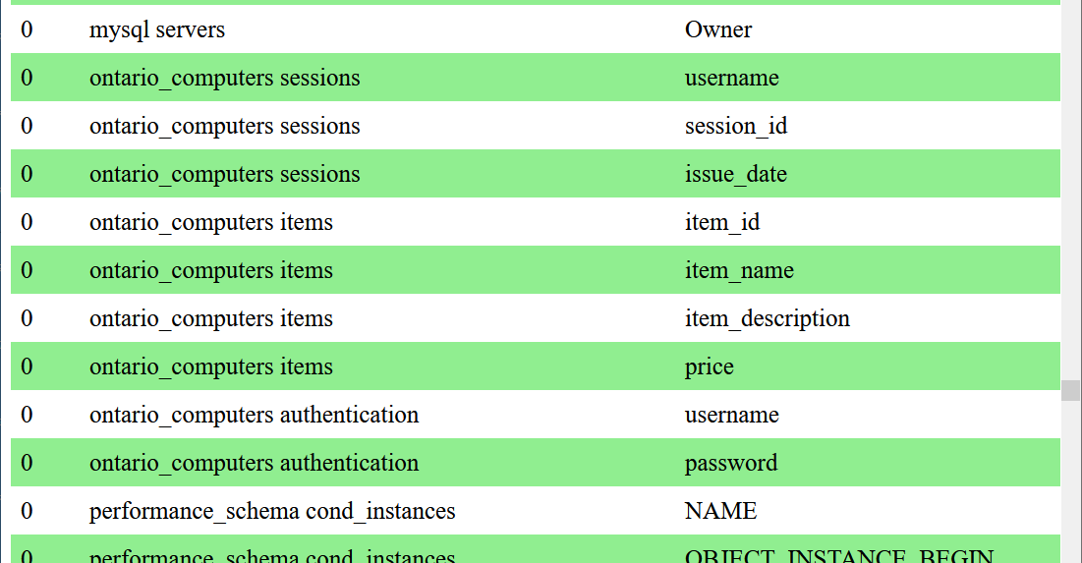
SQL Injection
So, our search becomes…
') UNION SELECT 0, CONCAT(TABLE_SCHEMA,' ', TABLE_NAME), COLUMN_NAME,0 FROM INFORMATION_SCHEMA.COLUMNS;
You may notice we added a,0 after column_name. This is because CONCAT is squeezing two columns into a single one which means we no longer have the same number of columns in both queries. Adding another “dummy” column of zeros fixes this.
And with that we get the data on the right. Now scroll down and find the records where the database is ontario_computers and you can see something interesting…

Slide 34
SQL Injection
There are actually three tables in this database!
One called authentication with columns username and password.
And another called sessions with columns username, session_id and issue_date
Wouldn’t it be nice to see what is in those tables too? Well, we can use SQL injection to find out what is in these tables too…

Slide 35
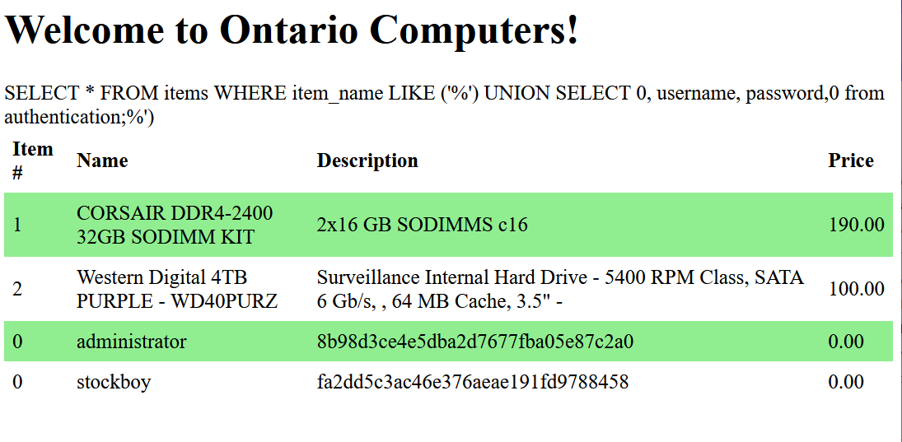
SQL Injection
To see the authentication table, we set the ?search= parameter to:
') UNION SELECT 0, username, password,0 from authentication;
From the image on the right, we can see there are two entries.
One for an administrator and one for a stockboy. Each one has a password which is a complicated series of numbers and letters.

Slide 36
SQL Injection
Just by looking at those long strings of numbers and letters we should be able to figure out what they are:
They are hashes. In fact, they are very likely MD5 hashes.
If you recall from your Asset Security class. MD5 hashes are very weak!
Here is a simple online tool you can use to try and crack them: https://www.cellphonetrackers.org/tool/md5-coder.php
Can you figure out what they are? If not, can you find other online tools to help?

Slide 37
The Vulnerability and its Defense
<HTML><HEAD><style> table { border-collapse: collapse; width: 100%; } th, td { text-align: left; padding: 8px; } tr:nth-child(even){background-color:Lightgreen;} </style></HEAD><BODY> <h1>Welcome to Ontario Computers!</h1> <table><tr><th>Item #</th><th>Name</th><th>Description</th><th>Price</th></tr> <?PHP $search = isset($_GET['search'])?" WHERE item_name LIKE ('%".$_GET['search']."%')":""; $dsn = 'mysql:dbname=ontario_computers;host=localhost’; $dbUser = 'appuser’; $password = 'Testing!’; $db = new PDO($dsn,$dbUser,$password); $query_string = "SELECT * FROM items".$search; print($query_string); $cursor = $db->query($query_string); while ( $data = $cursor->fetchObject() ) { printf("<tr><td>%d</td><td>%s</td><td>%s</td><td>%.2f</td></tr>",$data->item_id,$data->item_name,$data->item_description,$data->price); } ?></table></BODY></HTML>

Slide 38
SQL Injection
Just before we’re done here, we should take a quick look at the script that is vulnerable to this attack and figure out why. Let’s go through it line by line.
<HTML><HEAD><style> table { border-collapse: collapse; width: 100%; } th, td { text-align: left; padding: 8px; } tr:nth-child(even){background-color:Lightgreen;} </style></HEAD><BODY> <h1>Welcome to Ontario Computers!</h1> <table><tr><th>Item #</th><th>Name</th><th>Description</th><th>Price</th></tr> <?PHP $search = isset($_GET['search'])?" WHERE item_name LIKE ('%".$_GET['search']."%')":""; $dsn = 'mysql:dbname=ontario_computers;host=localhost’; $dbUser = 'appuser’; $password = 'Testing!’; $db = new PDO($dsn,$dbUser,$password); $query_string = "SELECT * FROM items".$search; print($query_string); $cursor = $db->query($query_string); while ( $data = $cursor->fetchObject() ){ printf("<tr><td>%d</td><td>%s</td><td>%s</td><td>%.2f</td></tr>",$data->item_id,$data->item_name,$data->item_description,$data->price); } ?></table></BODY></HTML>

Slide 39
SQL Injection
Removing the rest of the code and just focusing on the $search variable should help us see the problem. Like the script that allowed command injection. We have a string that uses the . operator to add data into our WHERE clause. This comes from whatever we put in ?search= . So, it’s easy for an attacker to put whatever they want into our query.
You may be thinking that we can use a similar technique to preventing command injection. By using trim() we could stop someone using quotes which they need to end the LIKE clause. Or perhaps use preg_match() to stop searches with the word UNION in them.
These are all possible but there is a much more elegant way: parameterized queries!
$search = isset($_GET['search'])?" WHERE item_name LIKE ('%".$_GET['search']."%')":""; $query_string = "SELECT * FROM items".$search; $cursor = $db->query($query_string);

Slide 40
SQL Injection
In our vulnerable PHP script, we used the query() function to send our SQL to the database. However, there is another way to do this. We can use two separate functions prepare() and execute().
Prepare() tells PHP the SQL we would like to send to the database – without sending it right away. It also allows us to specify which parts of this SQL are data. As you can see below the parts of the WHERE clause where the ?search= data would appear have been replaced with a question mark character instead.
We then use the execute() function this tells PHP to send the query -- we provide it with the data to replace the question mark.
$cursor = $db->prepare('SELECT name, colour, calories FROM fruit WHERE calories < ?’); $result = $cursor->execute([150]);

Slide 41
SQL Injection
After the SQL is executed, we loop over the $result instead of the $cursor.
The difference between parameterized queries and just constructing a query string using the . operator. Is that we are telling PHP whatever goes in place of the question mark is data and should never be executed as an SQL command.
The code on the following slide shows how to fix the vulnerability in our original store script. See if you can modify the script in your TurnKey Linux system in the same way!

Slide 42
SQL Injection
Just before we’re done here, we should take a quick look at the script that is vulnerable to this attack and figure out why. Let’s go through it line by line.
<HTML><HEAD><style> table { border-collapse: collapse; width: 100%; } th, td { text-align: left; padding: 8px; } tr:nth-child(even){background-color:Lightgreen;} </style></HEAD><BODY> <h1>Welcome to Ontario Computers!</h1> <table><tr><th>Item #</th><th>Name</th><th>Description</th><th>Price</th></tr> <?PHP $search = isset($_GET['search’])?"%".$_GET['search']."%":"%"; $dsn = 'mysql:dbname=ontario_computers;host=localhost’; $dbUser = 'appuser'; $password = 'Testing!'; $db = new PDO($dsn,$dbUser,$password); $query_string = "SELECT * FROM items WHERE item_name LIKE ?” print($query_string); $cursor = $db->prepare($query_string); $result = $cursor->execute([$search]); while ( $data = $result->fetchObject() ){ printf("<tr><td>%d</td><td>%s</td><td>%s</td><td>%.2f</td></tr>",$data->item_id,$data->item_name,$data->item_description,$data->price); } ?></table></BODY></HTML>

